Slide 1
Announcements
Project Phase 2 due date is on Sat (April 24 @ 8pm)
https://db.cs.pitt.edu/courses/cs1555/21-2/assign.html
Why do you never ask SQL people to help you move your furniture?
They sometimes drop the table

Slide 2
Database System Design

Slide 3

Data Modeling
Problem
?
MiniWorld
Reality of Interest
DBS
Modeling

Slide 4
Database System Life Cycle
Feasibility study
Requirements collection & analysis
Design
Prototype
Implementation
Validation and Testing
Operation

Slide 5
Design
Database Design
Database design is the activity of specifying the schema of a database in a given data model
Functional Design

Slide 6
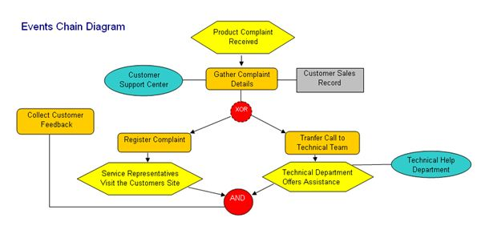
Functional Design
High-level specification of Transactions
DBMS-independent
Event diagrams, UML
Application program design
DBMS-specific (db Schema together with DML)
Language and environment-specific

Slide 7
Relational Database Design: The Good, The Bad and The Ugly
Bad design & anomalies
Normal forms
Universal Relational Approach
Decomposition – normalization

Slide 8

Relational Database Design
One single, large table
Simple ?
Good ? or Bad? Or just Ugly?

Slide 9
Goal
Design ‘good’ tables
define what ‘good’ means
fix ‘bad’ tables
in short: “we want tables where the attributes depend on the primary key, on the whole key, and nothing but the key”
Let’s see why, and how:

Slide 10
Bad Design
Relation Schema:
takes1 (ssn, cid, grade, name, address)
‘Bad’ - why?
because: ssn → (name, address)

Slide 11
Pitfalls
Redundancy
Waste of space (Repeated values, NULL)
Update anomalies (inconsistencies)
Elm
Insertion & Deletion anomalies

Slide 12
Insertion Anomaly
“jones” registers, but takes no class
Where do you store his address!?!

Slide 13
Deletion Anomaly
delete the last class record of ‘smith’
What about the address !?!
(we lose his address!)

Slide 14
Solution: decomposition
Split offending table in two (or more)
?
?

Slide 15
Functional dependencies
How do we split a bad table?
How do we recognize a bad table?
Set of rules: normal forms
Functional Dependencies (FD)
Let R=(A₁, A₂,…, A_{n}) and X⊆R and Y⊆R
X → Y if the value of X uniquely determines a value of Y
X functionaly determines Y
Y is functionally dependent on X

Slide 16
Functional Dependencies
They are not a property of a particular relation state
Property of R, not r(R)
They cannot be automatically inferred from r(R)
It can show which dependencies may exist
And show which dependencies cannot exist
Must have knowledge of the semantics of the attributes of R for the full story

Slide 17
Functional Dependency Examples I
A | B | C | D
a1 | b1 | c1 | d1
a1 | b2 | c1 | d2
a2 | b2 | c2 | d2
a2 | b2 | c2 | d3
a3 | b3 | c2 | d4
A → C ?
C → A ?
B → C ?
D → B ?
AB → D ?
YES
NO (line 5)
NO (line 3)
YES
NO (line 4)
a1
c1
a2
c2
a3

Slide 18
Functional Dependency Examples II
Loans (loan_number, branch, customer, amount)
loan_number → amount is satisfied
loan_number → branch is satisfied
amount → branch is not satisfied
loan_number → customer ?
takes1 (ssn, cid, grade, name, address)
ssn → (name, address)
(ssn, cid) → grade

Slide 19
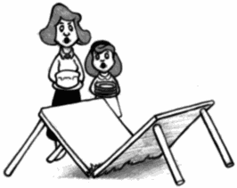
Decompositions
There are careless, ‘bad’ decompositions
There are correct decompositions
lossless
dependency preserving

Slide 20
Decomposition: lossless
Non-lossy decomposition is called lossless or non-additive decompositions
Definition:
Let R schema R, with FD ‘F’.
R1, R2 is a lossless decomposition of R if for all relations r(R), r1(R1) and r2(R2)
r1 r2 = r

Slide 21
Decomposition: lossy
R1(ssn, grade, name, address) R2(cid, grade)
ssn → (name, address)
(ssn, cid) → grade
✗
123 | 211 | A | Smith | Main
234 | 413 | A | Jones | Forbes
can not recover original table with a join!

Slide 22
Decomposition: lossless…
What about an easier criterion?
Theorem:
A decomposition is lossless if the joining attribute is a part of a superkey in at least one of the new tables
Formally:

Slide 23
Example: Loseless Decomposition
R1
R2
(ssn, cid) → grade
ssn → (name, address)
ssn → (name, address)
(ssn, cid) → grade

Slide 24
Dependency Preservation & Canonical Cover
We don’t want the original FDs to span two tables.
More specifically: … the FDs of the canonical cover
Canonical Cover is the minimum set of FDs without any trivial, extraneous and implied FDs
Example:
fd.1 A → B
fd.2 B → C
fd.3 AB → C
What is the canonical cover?
Keep only fd.1 & fd.2: A → B & B → C
A → B & B → C
=> AB → C
Notes:
fd.1 A  BC
fd.2 A  B
Keep only fd.1: A  BC

Slide 25
Rules of Inference: Armstrong’s Axioms
IR1 - Reflexivity rule:
if B ⊂ A, then A → B
e.g., If {ssn,name}⊇name then {ssn,name} → name
IR2 - Augmentation rule:
if A → B, then AC → BC
e.g., if ssn → name then {ssn,age} → {name,age}
IR3 - Transitive rule:
if A → B and B → C, then A → C
e.g., if ssn → Dno and Dno → Dname then ssn → dname

Slide 26
More Rules of Inference
IR4 - Decomposition rule:
if A → BC, then A → B and A → C
e.g., if ssn →{name, age} then ssn → name and ssn → age
IR5 - Union rule:
if A → B and A → C, then A → BC
e.g., if ssn → name and ssn → age then ssn →{name, age}
IR6 - Pseudotransitivity, Composition:
if A → B and CB → D implies CA → D
e.g., if isbn → title and {author, title} → pubdate then {author, isbn} → pubdate
IR7 - Self-determination: A → A

Slide 27
Decomposition: non-dependency preserving
Dependency preserving: the original (canonical) FDs should not span across tables
Non-dependency preserving example:
S# → (address, status)
address → status
S# → address
S# → status
quiz: is it lossless?
Notes:
[S: Airport Number] [Status: Quality of Life]
Fd1: S#-> address, fd2:S#-> status, fd3: address-> status
Fd2: redundant

Slide 28
Dependency Preserving Decomposition
Example
S# → (address, status)
address → status
S#→address
address→status
but: S# → status ?
why is dependency preservation good?
Notes:
1. S->address [S: Airport Number]
2. S->status
3. address->status [Status: Quality of Life]
But 1&3: S->status so 2. is redundant and can be dropped.

Slide 29
Why Dependency Preservation?
Insert the status for Athens to be A:
333 | Athens
Athens | A
S# → (address, status)
address → status
S#→address
address→status
Notes:
Insert (Athens, A)
Insert (333, NY) 333: JFK
Insert (334, NY) 334: LaGuardia

Slide 30
Decomposition - conclusions
decompositions should always be lossless
joining attribute -> superkey
Decompositions should be dependency preserving whenever possible

Slide 31
Testing for Loseless Decomposition
Given
relation schema R (A1, A2, …, An),
a set of functional dependencies F and
decomposition p = {R1, R2,…, Rm}
Steps:
Construct an m x n table S,
with a column for each of the n attributes in R and
row for each of the m relations in the decomposition.

Slide 32
Testing for Loseless Decomposition…
For each cell S(i,j) of S,
If the attribute for the column Aj is in the relation for the row Ri,
then set S(i,j) = k(j) to indicate known value
else set S(i,j) = u(i,j) to indicate unknown value
Consider each FD, X → Y F until no more changes can be made to S.
Look for rows whose X-column agrees
EQUATE Y-column
After all possible changes have been made to S,
If a row is made up entirely of symbols k(1), k(2), .., k(n) the join is lossless.
Otherwise, if there is no such row, the join is lossy.

Slide 33
Example
R (A,B,C,D,E)
Decomposition: R1(A,C), R2(A,B,D), R3(D,E)
FDs: A C, AB D, D E
 | A | B | C | D | E
R1(A,C)
R2(A,B,D)
R3(D,E)

Slide 34
Example
R (A,B,C,D,E)
Decomposition: R1(A,C), R2(A,B,D), R3(D,E)
FDs: A C, AB D, D E
Textbook notation
 | A | B | C | D | E
R1(A,C) | α(1,1) | β(1,2) | α(1,3) | β(1,4) | β(1,5)
R2(A,B,D) | α(2,1) | α(2,2) | β(2,3) | α(2,4) | β(2,5)
R3(D,E) | β(3,1) | β(3,2) | β(3,3) | α(3,4) | α(3,5)

Slide 35
Example
R (A,B,C,D,E)
Decomposition: R1(A,C), R2(A,B,D), R3(D,E)
FDs: A C, AB D, D E
 | A | B | C | D | E
R1(A,C) | K | U | K | U | U
R2(A,B,D) | K | K | U | K | U
R3(D,E) | U | U | U | K | K

Slide 36
Example
R (A,B,C,D,E)
Decomposition: R1(A,C), R2(A,B,D), R3(D,E)
FDs: A C, AB D, D E
 | A | B | C | D | E
R1(A,C) | K | U | K | U | U
R2(A,B,D) | K | K | K | K | U
R3(D,E) | U | U | U | K | K

Slide 37
Example
R (A,B,C,D,E)
Decomposition: R1(A,C), R2(A,B,D), R3(D,E)
FDs: A C, AB D, D E
 | A | B | C | D | E
R1(A,C) | K | U | K | U | U
R2(A,B,D) | K | K | K | K | K
R3(D,E) | U | U | U | K | K

Slide 38
Example (2)
R (A,B,C,D,E)
Decomposition: R1(A,C), R2(A,B,D), R3(D,E)
FDs: A C, AB D, E D
 | A | B | C | D | E
R1(A,C) | K | U | K | U | U
R2(A,B,D) | K | K | K | K | U
R3(D,E) | U | U | U | K | K
✗

Slide 39

Halloween Question?

Slide 40


Happy Halloween

Slide 41
Relational Database Design
One single, large table
Simple ?
Good ? or Bad? Or just Ugly?

Slide 42
Normal Forms
We discussed how to fix ‘bad’ schemas
but what is a ‘good’ schema?
Informally: “we want tables where the attributes depend on the primary key, on the whole key, and nothing but the key”
Formally: ‘good’, if it obeys a ‘normal form’
Typically: Boyce-Codd Normal form or the 3NF
Normal forms are defined in terms of FDs

Slide 43
Functional dependency
Definition: Let R=(A₁, A₂,…, A_{n}) and X⊆R and Y⊆R
X → Y if the value of X uniquely determines a value of Y
A functional dependency is a property of the meaning or semantic of the attributes in a relation schema.
We use our understanding of the semantics of the attributes of R – that is, how they relate to one another – to specify the FD that should hold on all relational instances.
Functional dependence is a semantic notion.
Recognizing the FDs is part of the process of understanding what data means.

Slide 44
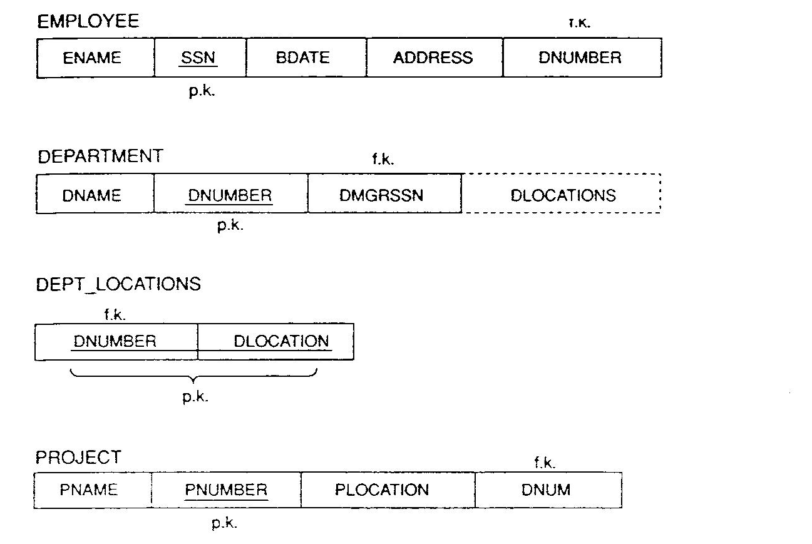
Good Database Schema
Relations should have simple meaning

Slide 45
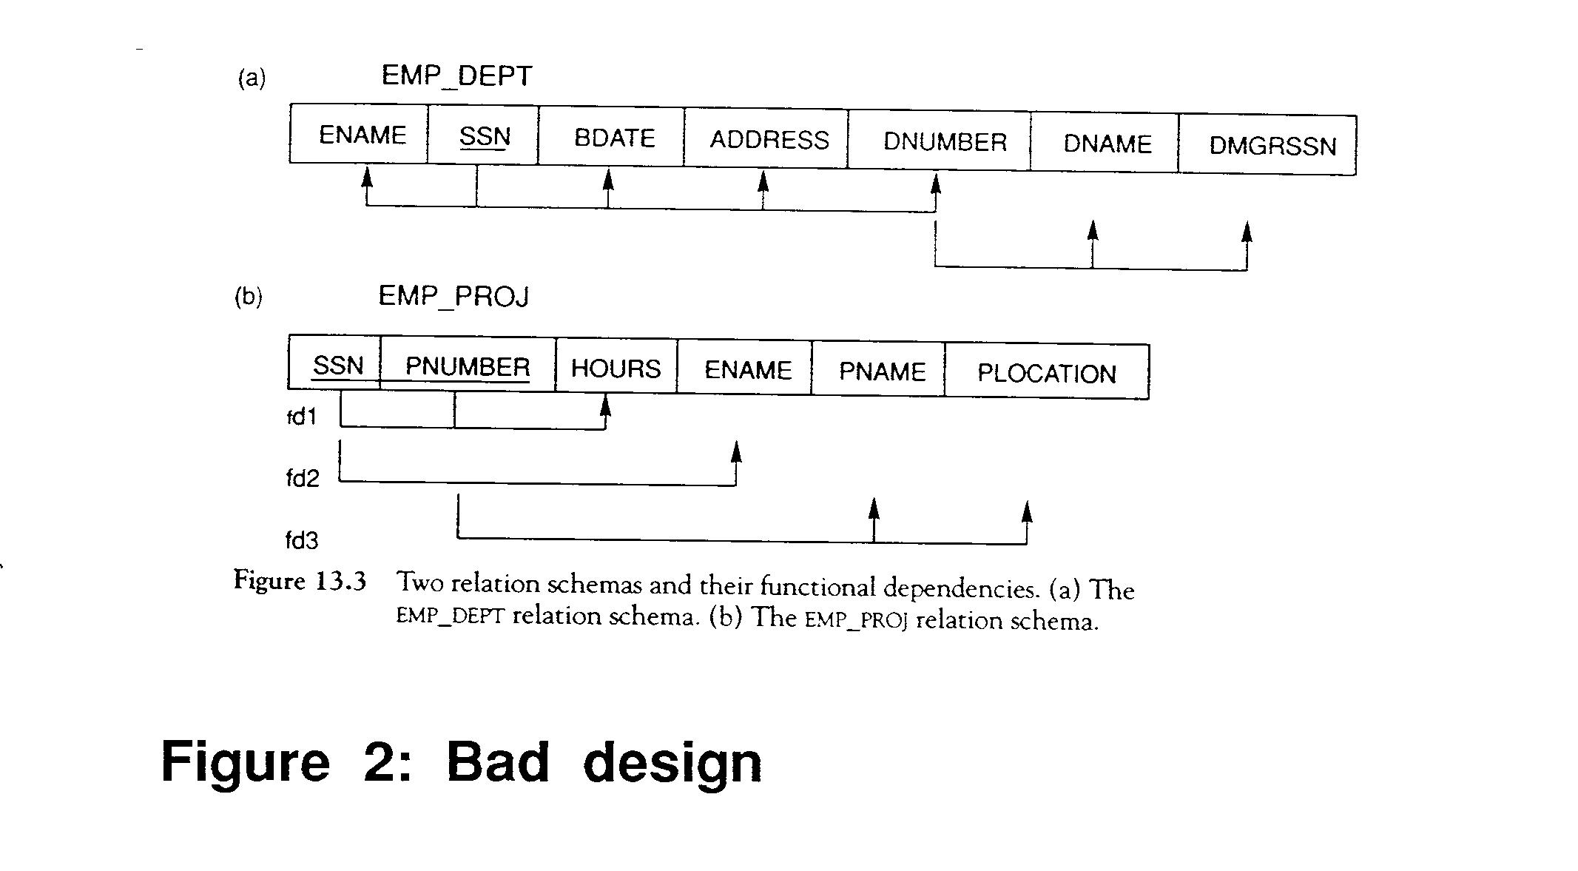
Bad Database Schema
Relations should not have multiple meanings

Slide 46
Types of Functional Dependencies
Trivial dependency: X→Y is trivial if it is true for any X and Y of any relation, regardless of X and Y semantics.
Ex1: A -> A
Ex2: If {A,B} a Key, then {A,B} → A (Y⊆X, X→Y is trivial)
Partial dependency: X→Y is partial if there is an attribute A in X that can be removed from X and the dependency can still hold: X–{A} → Y
E.g., SUPPLY (SID,PID,DID, SCity, DCity, Qty)
{SID, PID, DID} → Scity SID → SCity
{SID, PID, DID} → Dcity DID → Dcity
Full dependency: ??

Slide 47
Types of Functional Dependencies…
Transitive dependency: X→Y is transitive in R if there is a set of attributes Z that is not a subset of any key of R and both X → Z and Z → Y hold
E.g., EMP (SSN, EName, DeptID, MGRSSN)
(fd.1) SSN → DeptId
(fd.2) DeptId → MGRSSN
(from fd.1 & fd.2) SSN → MGRSSN
Multivalued dependency : X→Y is multivalued dependency in R if X is a key, Z in R and Z→Y
E.g., DJP (DeptID, ProjectID, part)
(fd.1) DeptId → part
(fd.2) ProjectID → part

Slide 48
Non-Relational Table
Unnormalized table/ NoSQL
MemID | Full Names | Address | Barcode | Movies Rented | Awards
1 | Janet Jones | First Street Plot No 4 | (0001, 0002) | (Pirates of the Caribbean, Clash of the Titans) | (15, 10)
2 | Robert Phil | 3rd Street 34 | (0003, 0004) | (Forgetting Sarah Marsal, Daddy’s Little Girls) | (16, 2)
3 | Robert Phil | 5th Avenue | 0005 | Clash of the titans | 10
Order Lists/ Arrays

Slide 49
First Normal Form
1NF: First Normal Form Every attribute has a single atomic value.
Example in 1NF
PK: MemID, Barcode
FD1: MemID → (Full Names, Address)
FD2: Barcode → Movies Rented
FD3: Movies Rented → Awards
MemID | Full Names | Address | Barcode | Movies Rented | Awards
1 | Janet Jones | First Street Plot No 4 | 0001 | Pirates of the Caribbean | 15
1 | Janet Jones | First Street Plot No 4 | 0002 | Clash of the Titans | 10
2 | Robert Phil | 3rd Street 34 | 0003 | Forgetting Sarah Marsal | 16
2 | Robert Phil | 3rd Street 34 | 0004 | Daddy’s Little Girls | 2
3 | Robert Phil | 5th Avenue | 0005 | Clash of the Titans | 10
Notes:
Section 1 / 2

Slide 50
Not in Second Normal Form
PK: MemID, Barcode
FD1: MemID → (Full Names, Address)
FD2: Barcode → Movies Rented
FD3: Movies Rented → Awards
X Movies Rented → Barcode
MemID | Full Names | Address | Barcode | Movies Rented | Awards
1 | Janet Jones | First Street Plot No 4 | 0001 | Pirates of the Caribbean | 15
1 | Janet Jones | First Street Plot No 4 | 0002 | Clash of the Titans | 10
2 | Robert Phil | 3rd Street 34 | 0003 | Forgetting Sarah Marsal | 16
2 | Robert Phil | 3rd Street 34 | 0004 | Daddy’s Little Girls | 2
3 | Robert Phil | 5th Avenue | 0005 | Clash of the Titans | 10
PK
FD1
FD2
FD3
Notes:
Section 1 / 2

Slide 51
Second Normal Forms
2NF: Second Normal Form
It is in 1NF and does not have partial dependencies.
Example NOT in 2NF (FD1 & FD2 partial dependencies)
PK: MemID, Barcode
MemID | Full Names | Address | Barcode | Movies Rented | Awards
1 | Janet Jones | First Street Plot No 4 | 0001 | Pirates of the Caribbean | 15
1 | Janet Jones | First Street Plot No 4 | 0002 | Clash of the Titans | 10
2 | Robert Phil | 3rd Street 34 | 0003 | Forgetting Sarah Marsal | 16
2 | Robert Phil | 3rd Street 34 | 0004 | Daddy’s Little Girls | 2
3 | Robert Phil | 5th Avenue | 0005 | Clash of the Titans | 10
PK
FD1
FD2
FD3
Notes:
Section 1 / 2

Slide 52
Second Normal Forms – Step 1
Left relation is in 2NF, but the right relation is not in 2NF
Partial dependency FD2
PK: MemID
PK: MemID, Barcode
MemID | Full Names | Address
1 | Janet Jones | First Street Plot No 4
2 | Robert Phil | 3rd Street 34
3 | Robert Phil | 5th Avenue
MemID | Barcode | Movies Rented | Awards
1 | 0001 | Pirates of the Caribbean | 15
1 | 0002 | Clash of the Titans | 10
2 | 0003 | Forgetting Sarah Marsal | 16
2 | 0004 | Daddy’s Little Girls | 2
3 | 0005 | Clash of the Titans | 10
FD1: MemID → (Full Names, Address)
FD2: Barcode → Movies Rented
FD3: Movies Rented → Awards
Notes:
Section 1 / 2

Slide 53
2NF Example (Movies Rented→Barcode)
MemID | Full Names | Address
1 | Janet Jones | First Street Plot No 4
2 | Robert Phil | 3rd Street 34
3 | Robert Phil | 5th Avenue
FD1: MemID → (Full Names, Address)
MemID | Barcode
1 | 0001
1 | 0002
2 | 0003
2 | 0004
3 | 0005
Barcode | Movies Rented | Awards
0001 | Pirates of the Caribbean | 15
0002 | Clash of the Titans | 10
0003 | Forgetting Sarah Marsal | 16
0004 | Daddy’s Little Girls | 2
0005 | Clash of the titans | 10
PK:
MemID, Barcode
FD2:
Barcode → Movies Rented
FD3: Movies Rented → Awards

Slide 54
Third Normal Forms
3NF: Third Normal Form
It is in 2NF and does not have transitive dependencies to attributes that are not part of a key.
If X→A is an FD then (a) it is trivial, or (b) X is a superKey, or (c) A is a subset of a candidate Key.
Example NOT in 3NF
Barcode | Movies Rented | Awards
0001 | Pirates of the Caribbean | 15
0002 | Clash of the Titans | 10
0003 | Forgetting Sarah Marsal | 16
0004 | Daddy’s Little Girls | 2
0005 | Clash of the Titans | 10
PK: Barcode
FD2: Barcode → Movies Rented
FD3: Movies Rented → Awards
X Movies Rented → Barcode
FD2
FD3
Notes:
Section 1 / 2

Slide 55
3NF Example
MemID | Full Names | Address
1 | Janet Jones | First Street Plot No 4
2 | Robert Phil | 3rd Street 34
3 | Robert Phil | 5th Avenue
FD1: MemID → (Full Names, Address)
MemID | Barcode
1 | 0001
1 | 0002
2 | 0003
2 | 0004
3 | 0005
Barcode | Movies Rented
0001 | Pirates of the Caribbean
0002 | Clash of the Titans
0003 | Forgetting Sarah Marsal
0004 | Daddy’s Little Girls
0005 | Clash of the titans
Movies Rented | Awards
Pirates of the Caribbean | 15
Clash of the Titans | 10
Forgetting Sarah Marsal | 16
Daddy’s Little Girls | 2
Clash of the titans | 10
PK:
MemID, Barcode
FD2:
Barcode → Movies Rented
FD3: Movies Rented → Awards

Slide 56
3NF Example
Example: X→A and A is a subset of a candidate Key.
PATIENT-VISIT (PATIENT,HOSPITAL,DOCTOR)
fd.1 (Patient, Hospital) → Doctor
fd.2 Doctor → Hospital
Pictorially:
It has a transitive dependency, but this is not to an attribute that are not part of a key.
Hospital is a subset of a candidate Key (fd.1)
Patient
Doctor
Hospital

Slide 57
Normal Forms - BCNF
Boyce-Codd Normal Form: A relation is in 3NF and has no transitive dependencies
if X → A is an FD, then (a) it is trivial, or (b) X is a superKey.
Informally: everything depends on the full key, and nothing but the key
Pictorially: we want a ‘star’ shape
G
B
D
A
C
E
H
Notes:
Doctor-Hospital (Doctor, Hospital) {Doctor-> Hospital}
Patient-Doctor (Patient, Doctor) {Patient → Doctor}
BUT this decomposition loses fd.1

Slide 58
3NF Example (BCNF)
MemID | Full Names | Address
1 | Janet Jones | First Street Plot No 4
2 | Robert Phil | 3rd Street 34
3 | Robert Phil | 5th Avenue
FD1: MemID → (Full Names, Address)
MemID | Barcode
1 | 0001
1 | 0002
2 | 0003
2 | 0004
3 | 0005
Barcode | Movies Rented
0001 | Pirates of the Caribbean
0002 | Clash of the Titans
0003 | Forgetting Sarah Marsal
0004 | Daddy’s Little Girls
0005 | Clash of the titans
Movies Rented | Awards
Pirates of the Caribbean | 15
Clash of the Titans | 10
Forgetting Sarah Marsal | 16
Daddy’s Little Girls | 2
Clash of the titans | 10
PK:
MemID, Barcode
FD2:
Barcode → Movies Rented
FD3: Movies Rented → Awards

Slide 59
Normal Forms - BCNF
or a star-like: (e.g., 2 candidate keys):
STUDENT(SSN, stID, name, address)
{ fd.1 SSN → name, fd.2 SSN → stID, fd.3 stID → SSN, fd.4 stID → address }
name
name
SSN
SSN
=
address
address
stID
stID

Slide 60
Normal Forms - BCNF
Theorem: given a schema R and a set of FD ‘F’, we can always decompose it to schemas R1, … Rn, so that
R1, …, Rn are in BCNF and
the decompositions is lossless
But, some decompositions might lose dependencies ⇒ use 3NF
3NF always loseless
3NF always preserves dependencies

Slide 61
BCNF & Dependency Preservation
BCNF is not always dependency preserving
Example: 3NF but not BCNF
PATIENT-VISIT (PATIENT, HOSPITAL,DOCTOR)
fd.1 (Patient, Hospital) → Doctor
fd.2 Doctor → Hospital
Possible Decomposition 1:
Doctor-Hospital (Doctor, Hospital) {Doctor → Hospital}
Patient-Doctor (Patient, Doctor) {Patient → Doctor}
Possible Decomposition 2:
Doctor-Hospital (Doctor, Hospital) {Doctor → Hospital}
Patient-Hospital (Patient, Hospital) {Patient → Hospital}
BUT these decompositions lose fd.1

Slide 62
Normal Forms - 4NF
Fourth Normal Form: A relation is in BCNF and has no Multivalue Dependencies
Example: FDC (FACULTY, Dept, Committee)
A faculty member can belong to more than one dept.
A faculty can be on several college-wide committees.
There is no relation between dept. and committee.
Anomalies? Change F101 from Budget to Admissions
FacultyID | Dept | Committee
F101 | CS | Budget
F101 | CoE | Budget
F101 | CS | Curriculum
F101 | CoE | Curriculum
F221 | Bio | Library
F330 | Math | Budget
F330 | Math | Admissions

Slide 63
Normal Forms - 4NF
Anomalies? Change F101 from Budget to Admissions
PK: FACULTY, Committee
PK: FACULTY, Dept
FacultyID | Committee
F101 | Budget
F101 | Curriculum
F221 | Library
F330 | Budget
F330 | Admissions
FacultyID | Dept
F101 | CS
F101 | CoE
F221 | Bio
F330 | Math
Admissions

Slide 64
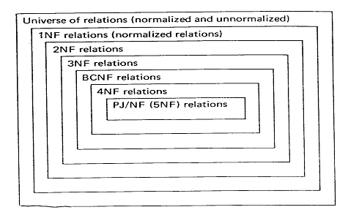
More Normal Forms…
5NF: Fifth Normal Form
No Join Dependencies
6NF: ….

Slide 65
Universal Relational Approach
One single, large table
Simple ?
Good ? or Bad? Or just Ugly?
Normalize it!

Slide 66
The Normalization Process
The process of finding good (stable) set of relations that is a faithful model of the enterprise.
Decomposition (top-down process)
start with a universal relation
identify functional dependencies
identify key(s)
If necessary, use decomposition to split the universal relation into a set of relations

Slide 67
Deriving the Keys of R from its FDs
Let X ⊆ R, X⁺ is its closure
Algorithm for finding the keys
X⁺ = X;
If ∃ an used U→V in FDs and U ⊆ X⁺
then goto step 3; else STOP;
X⁺ = X⁺ ∪ V;
If X⁺ = R then STOP; else goto step 2;
A primary key is one of the minimal keys

Slide 68
Deriving the Keys of R from its FDs
Example 1: R = (A, B, C), F = {A → B, B → C}
Derivation… all possible expansions & combinations
A⁺:
A → AB
→ ABC
✓
B⁺:
B → BC
→
✘
C⁺:
C →
✘
AB⁺: AB → ABC ✓
AC⁺: AC → ABC ✓
BC⁺: BC → ✘
ABC⁺: ABC → ABC ✓

Slide 69
Deriving the Keys of R from its FDs
Example 2: R = (A, B, C, D), F = {A → B, C → D}
Derivation… all possible expansions & combinations
A⁺:
A → AB
→
✘
B⁺:
B →
✘
C⁺:
C → CD
→
✘
D⁺:
D →
✘
AB⁺: AB → AB → ✘
AC⁺: AC → ABC → ABCD ✓
AD⁺: AD → ABD → ✘
BC⁺: BC → BCD → ✘
BD⁺: BD → ✘
CD⁺: CD → ✘
ABC⁺: ABC → ABCD ✓
ABD⁺: ABD → ✘
ACD⁺: ACD → ABCD ✓
BCD⁺: BCD → ✘
ABCD⁺: ABCD → ABCD ✓

Slide 70
Optimization in Deriving the Keys from FDs
Example 2: R = (A, B, C, D), F = {A → B, C → D}
Observation: If an attribute appears in RHS of a FD, it means that it cannot be part of the minimal key.
Let X = ∪_{i} RHS_{i} , then Key = R – X
Key = (A, B, C, D) – (B, D) = (A, C)
AB⁺: AB → AB → ✘
AC⁺: AC → ABC → ABCD ✓
AD⁺: AD → ABD → ✘
BC⁺: BC → BCD → ✘
BD⁺: BD → ✘
CD⁺: CD → ✘
A⁺:
A → AB
→
✘
B⁺:
B →
✘
C⁺:
C → CD
→
✘
D⁺:
D →
✘

Slide 71
BCNF Decomposition Algorithm
result := {R}; done := false; compute F ⁺; while (not done) do if (there is a schema R_{i} in result that is not in BCNF) then begin let α → β be a nontrivial FD that holds on R_{i} such that α → R_{i} is not in F ⁺, and α ∩ β = ∅; result := (result – R_{i} ) ∪ (R_{i} – β) ∪ (α, β ); end else done := true;
Note: each R_{i} is in BCNF, and decomposition is lossless-join.

Slide 72
Universal Relation: Example of BCNF Decomposition
R = (branch_name, branch_city, assets,
customer, loan_number, amount)
F = {branch_name → (assets, branch_city),
loan_number → (amount, branch_name)}
Key = {loan_number, customer}
Decomposition
R₁ = (branch_name, assets, branch_city)
R₂ = (branch_name, customer, loan_number, amount)
R₃ = (branch_name, loan_number, amount)
R₄ = (customer, loan_number)
Final decomposition: R₁, R₃, R₄
Notes:
Add customer_name so that we have R5 (customer, customer_name) to be able to insert customer info.

Slide 73
Synthesis (bottom-up process)
Begin with attributes and combine them into related group using functional dependencies to develop a set of normalized relations.
A synthesis algorithm was developed by Bernstein.
Basic steps:
- make a list of all FDs
- groups together those with the same determinant
- construct a relation of each group.

Slide 74
Synthesis… Elaborated steps
Make a list of all FDs.
Eliminate extraneous attributes in each FD.
Remove any redundant FDs and find a non redundant covering of the input FDs.
- Combine FD groups with equivalent key.
Group together those with the same determinant.
Construct a relation for each group.
If none of the resulting relations has the same key as one of the keys of the original universal relation, we add another relation containing one of the keys, with an empty FD set.

Slide 75
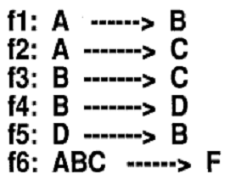
Example 1: Consider the following set of FDs.
Q: Using Synthesis construct a set 3NF relations.

Slide 76
Example 1 Solution
f1: A→B
f2: A→C
=> A→BC
union
=> f1: A→ABC
f6: ABC→F
A→F (f6’)
f1: A→B
f3: B→C
=> A→C
trans
Which is f2 so f2 is redundant
f1: A→B
f6’:A→F f3: B→C
f4: B→D
f5: D→B
R1 (A,B,F)
R2 (B,C,D)
R3 (D, B)
R1 (A,B,F)
R4 (B,C,D)
BCNF (3NF)
BCNF
(3NF)
R2: Does not contain transitive FD
R4: Contains transitive FD (f5)
Key = {A,B,C,D,F} - {B,F,C,D} = A
 | A | B | C | D | F
R1 | K | K | U K | U K | K
R4 | U | K | K | K | U

Slide 77
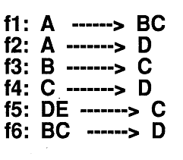
Example 2: Consider the following set of FDs.
Q: Using Synthesis construct a set 3NF relations.

Slide 78
Design Goals
Goal:
BCNF
Lossless join
Dependency preservation
If we cannot achieve this, we accept one of
Lack of dependency preservation
Redundancy due to use of 3NF
Note, SQL does not provide a direct way of specifying FDs other than superkeys.
Can specify FDs using assertions, but they are expensive
Hard to test a FD whose left hand side is not a key

Slide 79
Conclusions
Disadvantages of Normal Forms
It is not constructive. It does not provide a way to get a good design.
It can only be applied after we have a schema and tell if it is good or not.
It provides no conceptual design. It deals directly with relations and attributes.
It can be applied (more or less) only to relational schemas.
Schema Design: Conceptual Design
Entity-Relationship (E-R) or UML
In practice, E-R diagrams usually lead to tables in BCNF

Slide 80
Example 2 Solution
f1: A→BC
=>f1.1:A→B
f1.2:A→C is redundant (f1.1 + f3)
f2:A→D is redundant (f1 + f6)
f6: BC→D
f3: B→C
=>B→D
is redundant (f3+f4)
f1.1: A→B
f3’:B→C f4: C→D
f5: DE→C
R1(A,B) BCNF
R2 (B,C) BCNF
R3 (C,D,E) 3NF
*Can we generate the original universal R?
Yes if its key is part of R1 or R2 or R3
*The key is (A,E) so we need R4 (A,E)

Slide 81
Normal Forms Summary
1NF: First Normal Form Every attribute has a single atomic value.
2NF: Second Normal Form
It is in 1NF and does not have partial dependencies.
3NF: Third Normal Form
It is in 2NF and does not have transitive dependencies to attributes that are not part of a key.
If X→A is an FD then (a) it is trivial, or (b) X is a superKey, or (c) A is a subset of a candidate Key.
Boyce-Codd Normal Form: A relation is in 3NF and has no transitive dependencies
if X → A is an FD, then (a) it is trivial, or (b) X is a superKey.
Notes:
Section 1 / 2

